Slide 1

Fundamental Of Structured Programming Lecture 7
By
Dr. Ahmed Yousry
Lecturer, Computer Science Department,
Faculty of computers and artificial intelligence, benha university

Slide 2


Slide 3
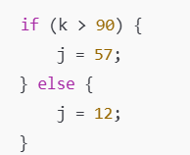
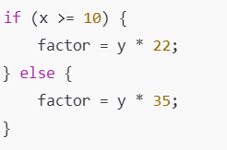
Exercise
The following statements use conditional expressions. Rewrite each with an if/else statement.
j = k > 90 ? 57 : 12;
factor = x >= 10 ? y * 22 : y * 35;

Slide 4
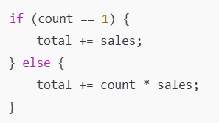
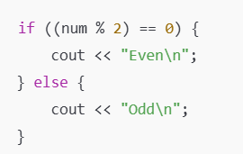
Exercise
C) total += count == 1 ? sales : count * sales;
D) cout << ((num % 2) == 0) ? "Even\n" : "Odd\n";

Slide 5

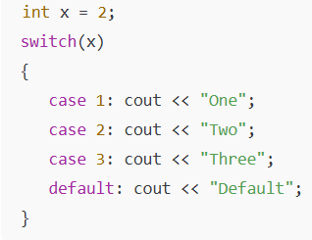
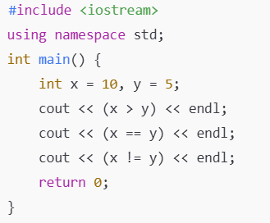
What is the output
1
1
0
1
OneTwoThreeDefault

Slide 6
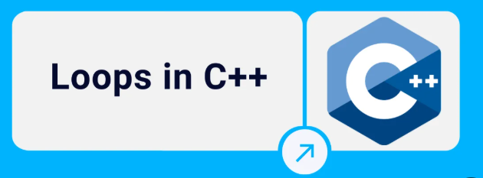
Chapter 5

Slide 7
The Increment and Decrement Operators
Increment – increase value in variable
++ adds one to a variable
val++; is the same as val = val + 1;
Decrement – reduce value in variable
-- subtracts one from a variable
val--; is the same as val = val – 1;
can be used in prefix mode (before) or postfix mode (after) a variable
Notes:
See pr5-04.cpp

Slide 8
Prefix Mode
++val and --val increment or decrement the variable, then return the new value of the variable.
It is this returned new value of the variable that is used in any other operations within the same statement.
int x = 1, y = 1;
x = ++y; // y is incremented to 2 ,then 2 is assigned to x
cout << x << " " << y; // Displays 2
x = --y; // y is decremented to 1 ,then 1 is assigned to x
cout << x << " " << y; // Displays 1

Slide 9
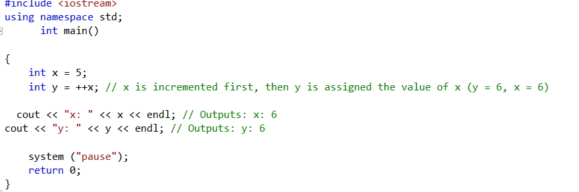
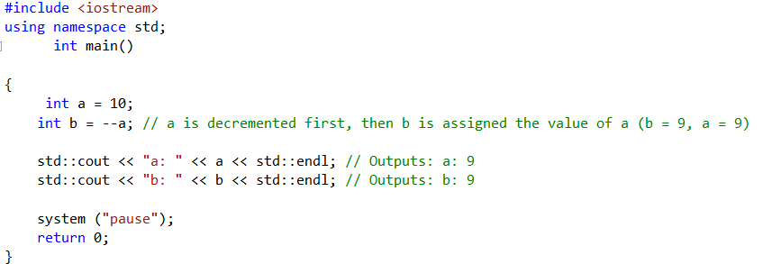
Example

Slide 10
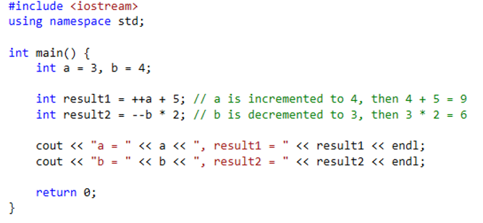
Example
Program Output:
a = 4, result1 = 9
b = 3, result2 = 6

Slide 11
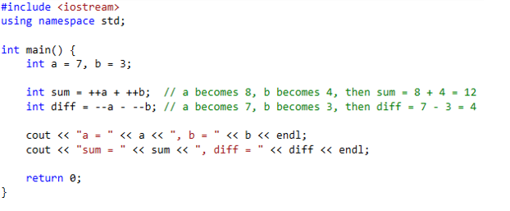
Example
Program Output:
a = 7, b = 3
sum = 12, diff = 4

Slide 12
Postfix Mode
val++ and val-- return the old value of the variable, then increment or decrement the variable
It is this returned old value of the variable that is used in any other operations within the same statement

Slide 13
Postfix Mode Example
int x = 1, y = 1;
x = y++; // y++ returns a 1
// The 1 is assigned to x
// and y is incremented to 2
cout << x << " " << y; // Displays 1 2
x = y--; // y-- returns a 2
// The 2 is assigned to x
// and y is decremented to 1
cout << x << " " << y; // Displays 2 1
Notes:
See pr5-05.cpp

Slide 14
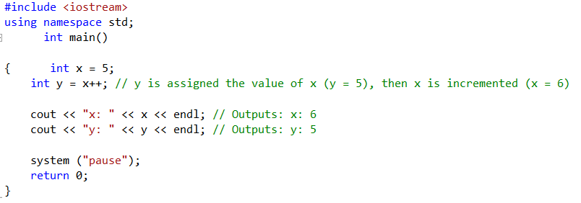

Example

Slide 15
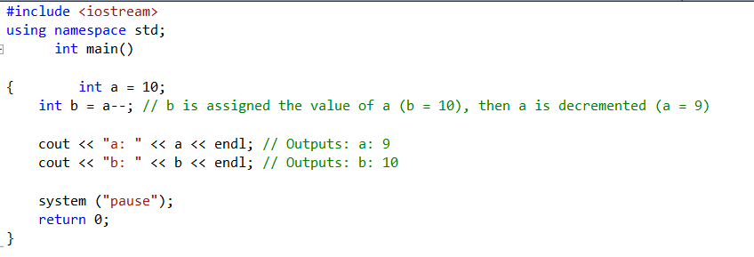
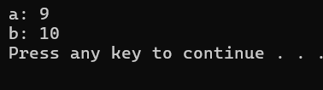
Example

Slide 16
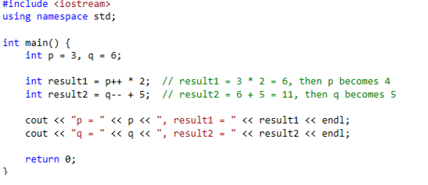
Example
Program Output:
p = 4, result1 = 6
q = 5, result2 = 11

Slide 17
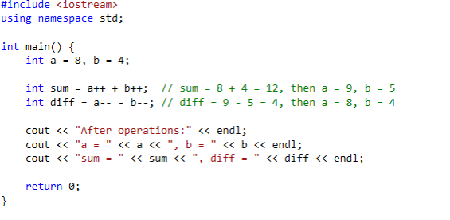
Example
Program Output:
After operations:
a = 8, b = 4
sum = 12, diff = 4

Slide 18
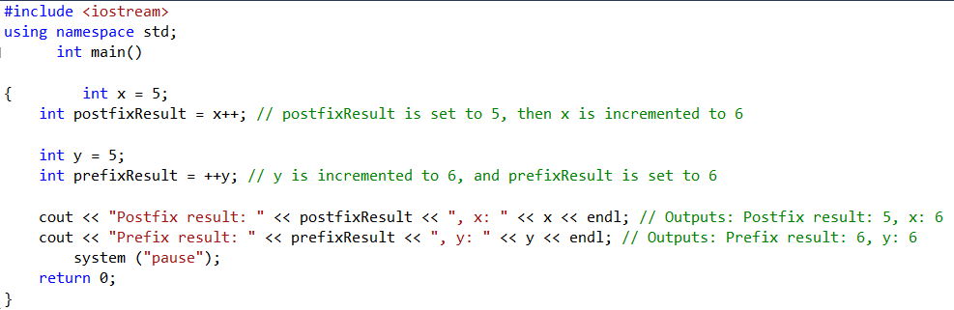

Example

Slide 19
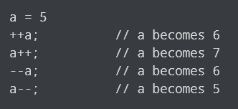
Postfix and Prefix Mode Example

Slide 20
Prefix vs. Postfix - Examples
int num, val = 12;
cout << val++; // displays 12,
// val is now 13;
cout << ++val; // sets val to 14,
// then displays it
num = --val; // sets val to 13,
// stores 13 in num
num = val--; // stores 13 in num,
// sets val to 12

Slide 21
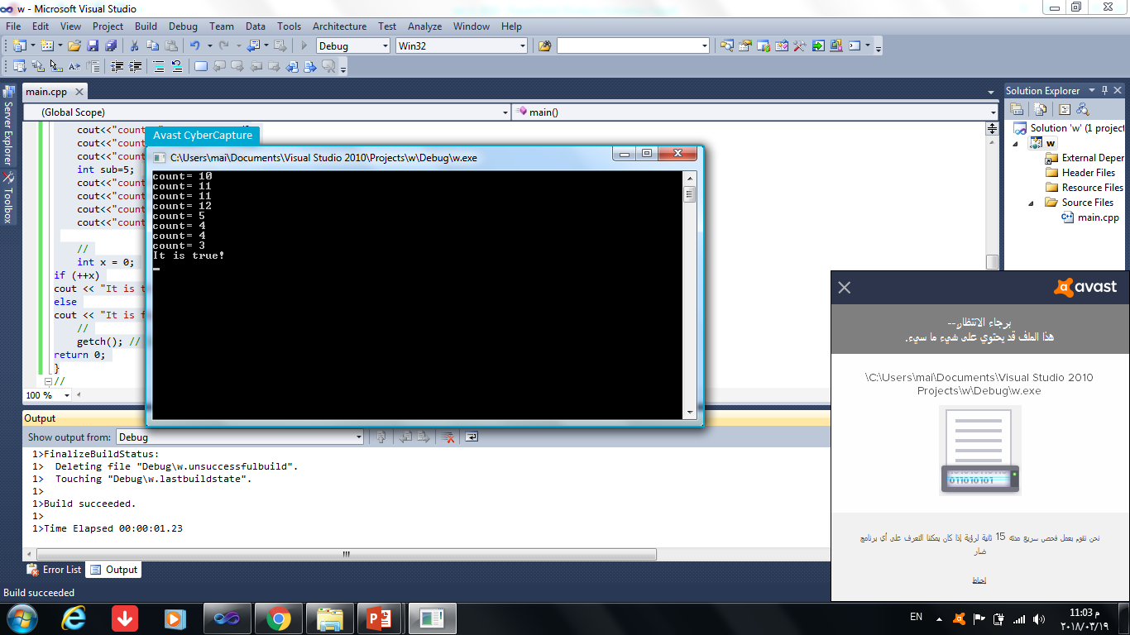
Increment and decrement operator What is the output?
#include<iostream>
using namespace std;
int main()
{
int count=10;
cout<<"count= "<<count<<endl;
cout<<"count= "<<++count<<endl;
cout<<"count= "<<count++<<endl;
cout<<"count= "<<count<<endl;
int sub=5;
cout<<"count= "<<sub<<endl;
cout<<"count= "<<--sub<<endl;
cout<<"count= "<<sub--<<endl;
cout<<"count= "<<sub<<endl;
system("pause");
return 0; }

Slide 22
Increment & Decrement Notes
Can be used in arithmetic expressions
result = num1++ + --num2;
Must be applied to something that has a location in memory. Cannot have
result = (num1 + num2)++; //Illegal
Can be used in relational expressions
if (++num > limit)
Pre- and post-operations will cause different comparisons

Slide 23
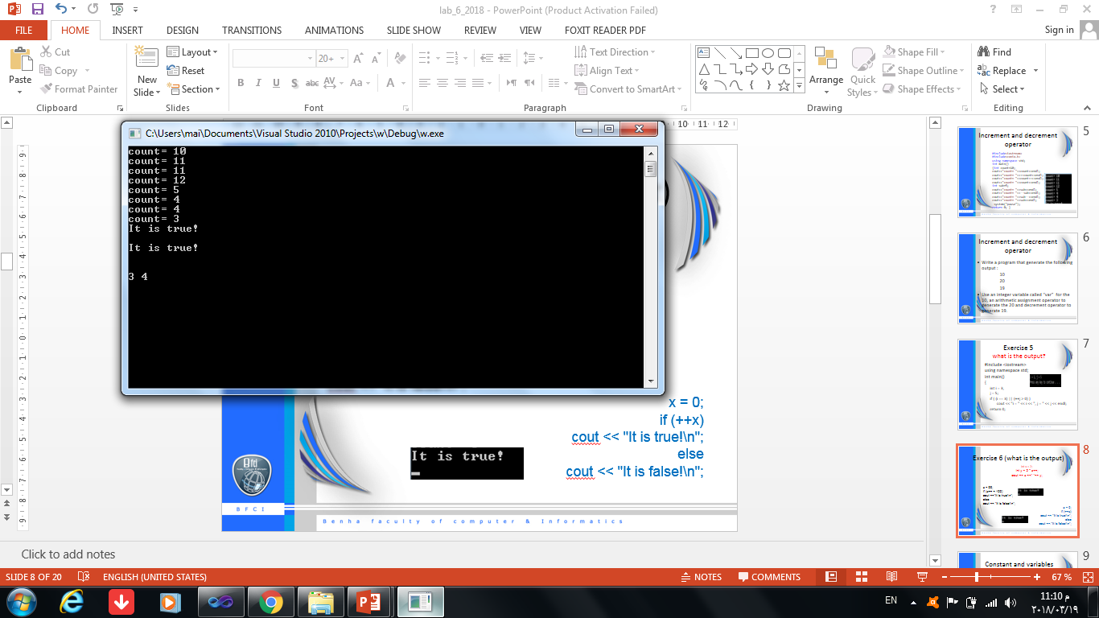
Exercise(what is the output?)
int x = 2;
int y = 2 * x++;
cout << x <<" "<< y;
x = 99;
if (x++ < 100)
cout <<"It is true!\n";
else
cout << "It is false!\n";
x = 0;
if (++x)
cout << "It is true!\n";
else
cout << "It is false!\n";

Slide 24
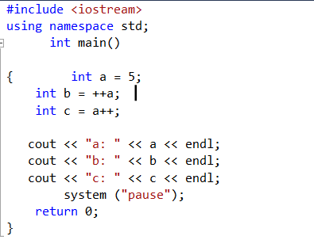
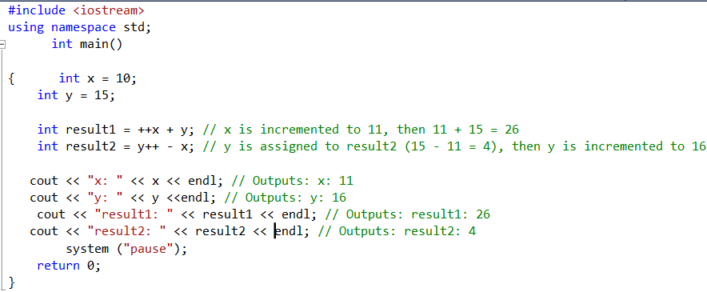
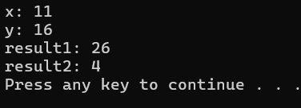
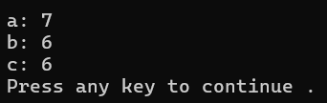
Exercise

Slide 25
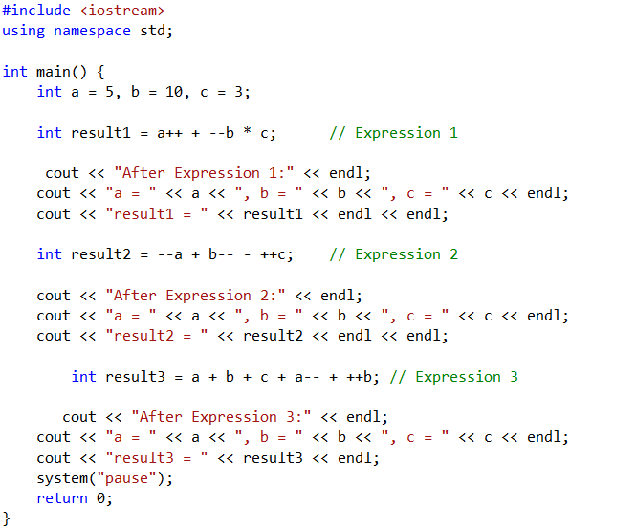



Example

Slide 26
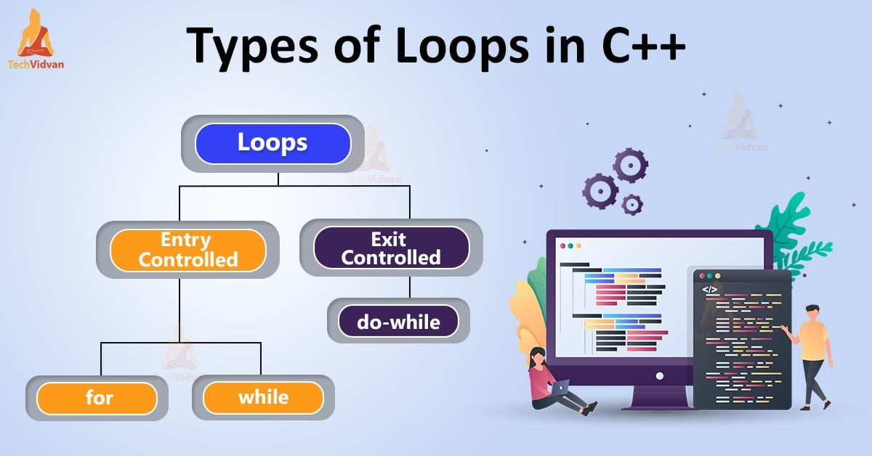

Slide 27
Conditional Statements
The order of statement execution through a method is linear: One statement after another in sequence.
Some programming control statements allow us to:
Decide whether to execute a particular statement (Selection/Conditional Statements).
Execute a statement over and over, repetitively (Repetition Control Statement)

Slide 28
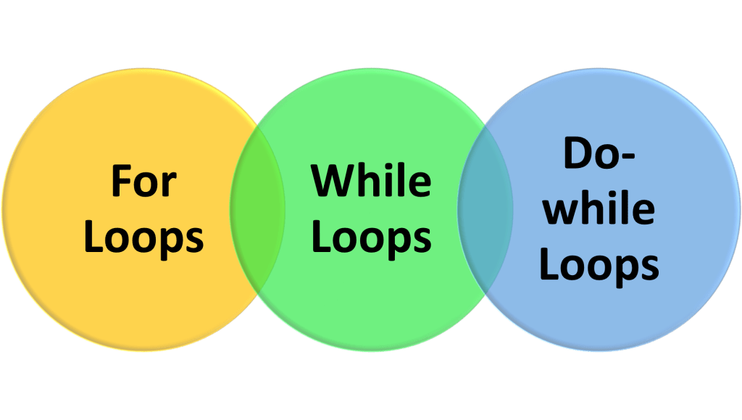
Loops
Iteration/Repetition Statements
A loop allows you to execute a block of code repeatedly as long as a certain condition is true.
A loop is a control structure that determines how many times an operation or a sequence of operations is repeatedly executed.
There are three main types of loops in Java:
while Loop
do-while Loop
for Loop

Slide 29
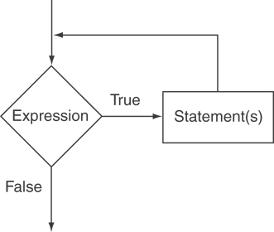
The while Loop
Loop: a control structure that causes a statement or statements to repeat
General format of the while loop:
while (expression)
statement;
statement; can also be a block of statements enclosed in { }

Slide 30
while Loop – How It Works
while (expression)
statement;
While is a pre-test loop.
expression is evaluated
if true, then statement is executed, and expression is evaluated again.
if false, then the loop is finished and program statements following statement execute.

Slide 31
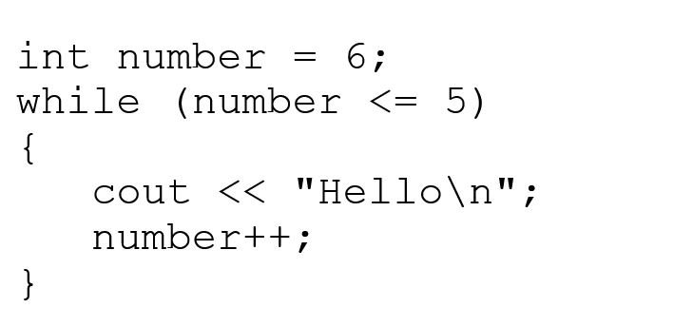
while Loop Example
int val = 5;
while (val >= 0)
{ cout << val << " ";
val = val - 1;
}
produces output:
5 4 3 2 1 0
Notes:
See pr5-01.cpp

Slide 32
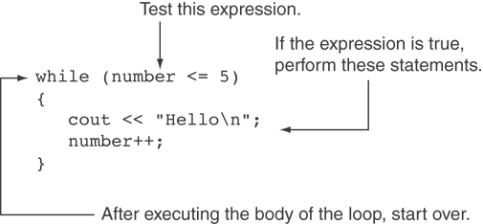
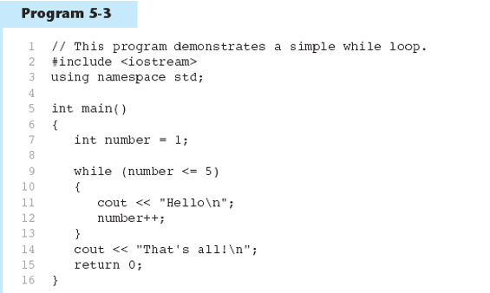
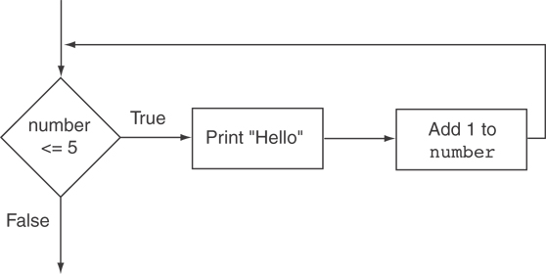
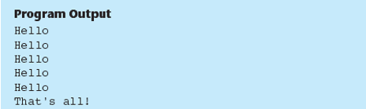
Example

Slide 33
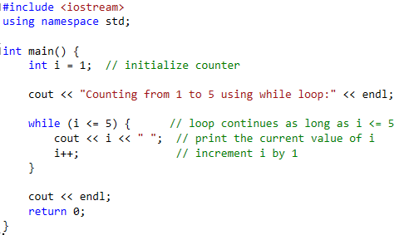
Example: Printing numbers using a while loop
Program Output:
Counting from 1 to 5 using while loop:
1 2 3 4 5

Slide 34
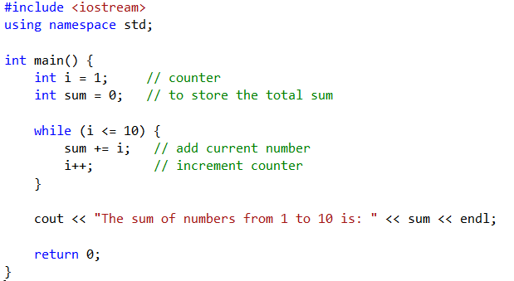

Example: Write a program to find the sum of numbers from 1 to 10 using a while loop

Slide 35
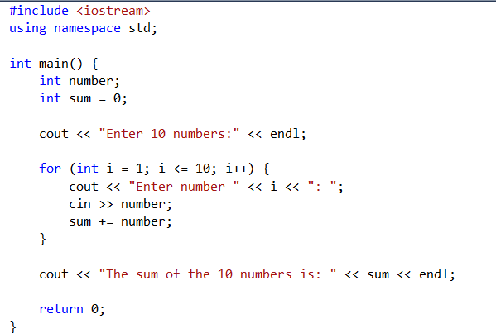
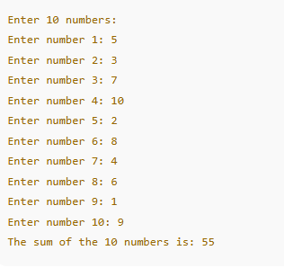
Example: Write a program that computes the sum of 10 numbers entered by the user

Slide 36
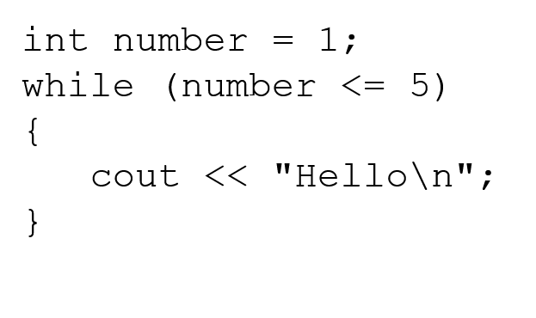
Exiting the Loop
The loop must contain code to allow condition to eventually become false so the loop can be exited
Otherwise, you have an infinite loop (i.e., a loop that does not stop)
Example infinite loop:
x = 5;
while (x > 0) // infinite loop because
cout << x;// x is always > 0

Slide 37
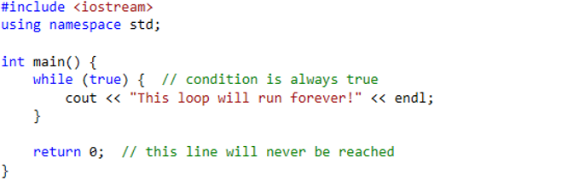
Example

Slide 38
Common Loop Errors
Don’t put ; immediately after(condition)
Don’t forget the { }
int numEntries = 1;
while (numEntries <=3)
cout << "Still working … ";
numEntries++; // not in the loop body
Don’t use = when you mean to use ==
while (numEntries = 3) // always true
{
cout << "Still working … ";
numEntries++;
}

Slide 39
Using the while Loop for Input Validation
Input validation is the process of inspecting data that is given to the program as input and determining whether it is valid.
The while loop can be used to create input routines that reject invalid data, and repeat until valid data is entered.

Slide 40
Using the while Loop for Input Validation
Loops are an appropriate structure for validating user input data
Prompt for and read in the data.
Use a while loop to test if data is valid.
Enter the loop only if data is not valid.
Inside the loop, display error message and prompt the user to re-enter the data.
The loop will not be exited until the user enters valid data.
Notes:
See pr5-03.cpp

Slide 41
Input Validation Loop Example
cout << "Enter a number (1-100) and"
<< " I will guess it. ";
cin >> number;
while (number < 1 || number > 100)
{ cout << "Number must be between 1 and 100."
<< " Re-enter your number. ";
cin >> number;
}
// Code to use the valid number goes here.

Slide 42
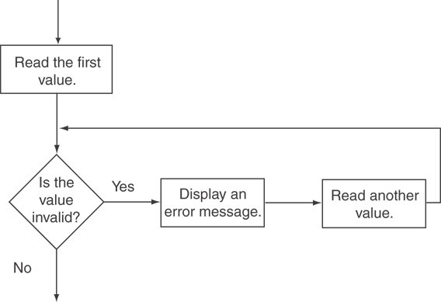
Example
cout << "Enter a number less than 10: ";
cin >> number;
while (number >= 10)
{
cout << "Invalid Entry!" << "Enter a number less than 10: ";
cin >> number;
}

Slide 43
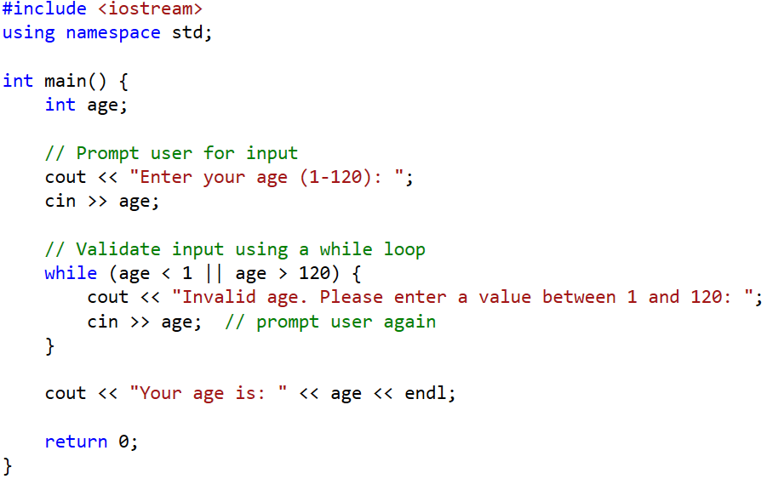
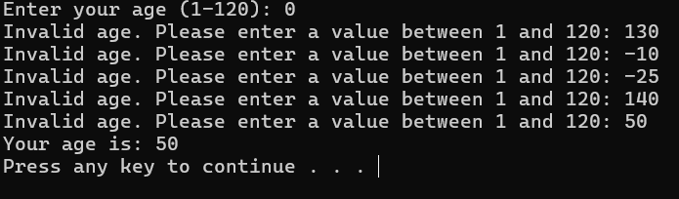
Example

Slide 44
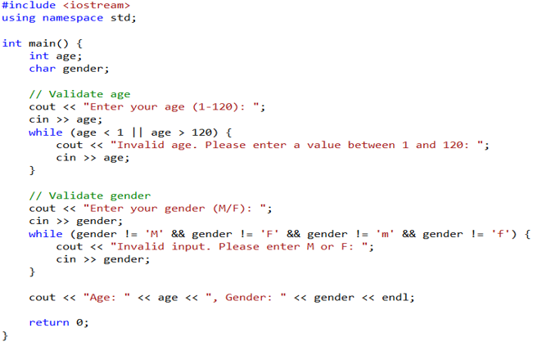
Example

Slide 45
Counters
Counter: a variable that is incremented or decremented each time a loop repeats
Can be used to control execution of the loop (also known as the loop control variable)
Must be initialized before entering loop

Slide 46
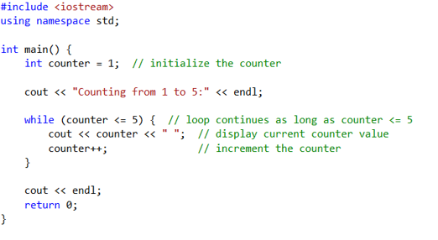
Example
Program Output:
Counting from 1 to 5:
1 2 3 4 5

Slide 47
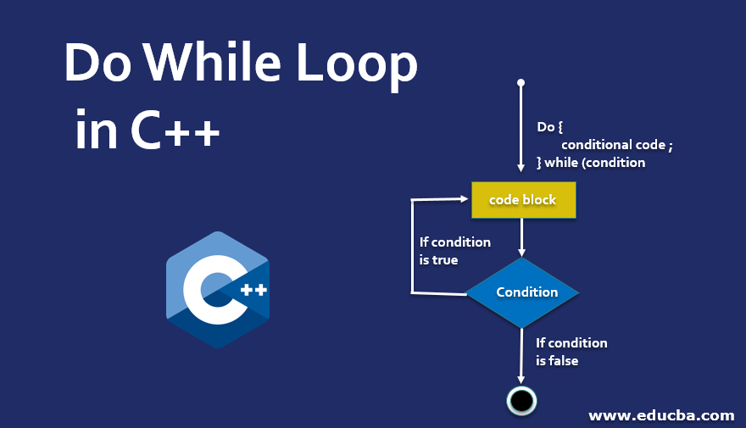

Slide 48
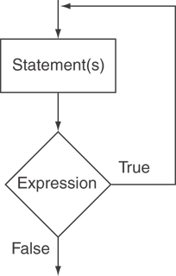
The do-while Loop
do-while: a post-test loop – execute the loop, then test the expression.
General Format:
do
statement;// or block in{ }
while (expression);
Note that: a semicolon is required
after do while(expression)

Slide 49
do-while Loop Notes
Loop always executes at least once
Execution continues as long as condition is true; the loop is exited when condition becomes false
{ } are required, even if the body contains a single statement
; after (condition) is also required
Notes:
See pr5-08.cpp

Slide 50
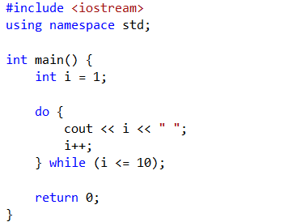

Example: Program that prints the numbers from 1 to 10 using a do-while loop:

Slide 51
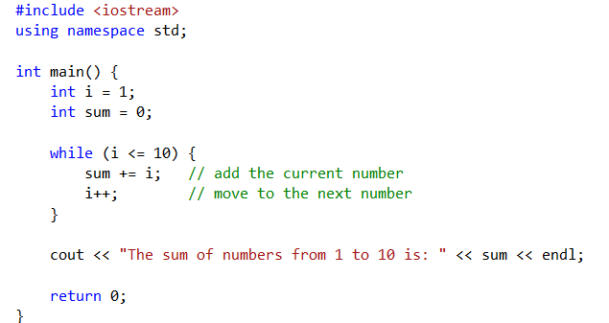

Example: sum number from 1 to 10

Slide 52
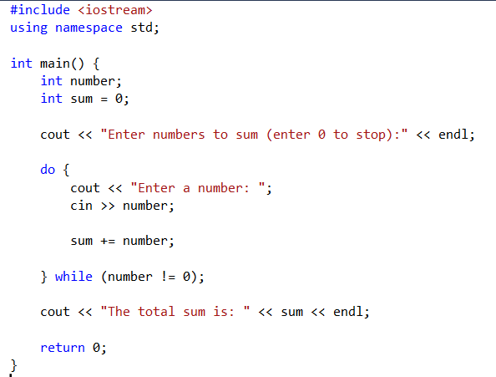
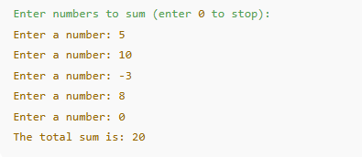
Example:
a do-while loop in C++ that calculates the sum of user-entered numbers until the user enters 0 to stop:

Slide 53

Example
Enter number: 5
Enter number: 6
Enter number: 8
Enter number: 45
Enter number: -1
from 1 to 25: 3
from 26 to 40: 0
from 41 to 50: 1
Out of range: 1

Slide 54
Menu-Driven Program Example
do {
// code to display menu
// and perform actions
cout << "Another choice? (Y/N) ";
} while (choice =='Y'||choice =='y');
The condition could be written as
(toupper(choice) == 'Y');
or as
(tolower(choice) == 'y');
Notes:
See pr5-09.cpp

Slide 55


Example

Slide 56

Output

Slide 57

Example

Slide 58


Slide 59

The for Loop
Useful for counter-controlled loop.
General Format:
for(initialization; test; update)
statement; // or block in { }
No semicolon after 3rd expression or after the ”)”.

Slide 60

for Loop - Mechanics
for(initialization; test; update)
statement; // or block in { }
Perform initialization.
Evaluate test expression :
If true, execute statement
If false, terminate loop execution
Execute update, then re-evaluate test expression.

Slide 61
for Loop Example
int sum = 0, num;
for (num = 1; num <= 10; num++)
sum += num;
cout << "Sum of numbers 1 – 10 is "
<< sum << endl;
Notes:
See pr5-10.cpp

Slide 62

Example: print number
Program Output:
Counting from 1 to 5 using a for loop:
1 2 3 4 5

Slide 63

Example
Program Output:
Counting down from 5 to 1 using a for loop:
5 4 3 2 1

Slide 64


Example: Sum number from 1 to 10

Slide 65

Example: program that calculates the sum of 10 numbers entered by the user
Output
2 5 3 7 1 4 6 8 9 10
The sum of the 10 numbers is: 55

Slide 66
for Loop Modifications
Initialization and update code can contain more than one statement
Separate the statements with commas
Example:
for (int sum = 0, num = 1; num <= 10; num++)
sum += num;
Can omit initialization if already done
int sum = 0, num = 1;
for (; num <= 10; num++)
sum += num;

Slide 67
More for Loop Modifications
Can omit update if done in loop
for (sum = 0, num = 1; num <= 10;)
sum += num++;
Can omit test – may cause an infinite loop
for (sum = 0, num = 1; ; num++)
sum += num;

Slide 68
Sentinels
sentinel: value in a list of values that indicates end of the list
Special value that cannot be confused with a valid value, e.g., -999 for a test score
Used to terminate input when user may not know how many values will be entered

Slide 69
Sentinel Example
int total = 0;
cout << "Enter points earned "
<< "(or -1 to quit): ";
cin >> points;
while(points != -1)//-1 is the sentinel
{
total += points;
cout <<"Enter points earned: ";
cin >> points;
}
Notes:
See pr5-12.cpp

Slide 70

Example

Slide 71
Deciding Which Loop to Use
while: pretest loop (loop body may not be executed at all)
do-while: post test loop (loop body will always be executed at least once)
for: pretest loop (loop body may not be executed at all); has initialization and update code; is useful with counters or if precise number of repetitions is known

Slide 72



Exercise_1
Write a C++ program to print all even numbers between 1 to 100. - using loop:

Slide 73

Exercise_2
Using loops to calculate the factorial of a positive integer entered by the user.

Slide 74

Do-while

Slide 75

For loop

Slide 76
Example
Identify the problem in the following program. What happens if you compile and execute the program?
int main()
{
int i;
for (i = 5; i > 0; i--)
i++;
return 0;
}

Slide 77
Thank you

